Slide 1
Steps to Degree Completion: APPC & FRF for MS/MA/MFA Programs

Slide 2
Application to Candidacy
This is the department’s confirmation that the student has completed all courses towards the master’s degree, or is currently enrolled in the final course(s) towards the master’s degree
What is left to complete?
Defense & Thesis (for Plan I & III students)
or
Comp Exam (for Plan II students)

Slide 3
Timing: Advancement/Graduation
The vast majority of academic master’s students advance & graduate in the same quarter.
Degree completion paperwork is a two-step process:
Advance: Application to Candidacy (APPC) due 3rd Friday of the quarter
Graduate: Final Report Form (FRF) due last day of the quarter
Students completing their requirements via a defense & thesis sometimes take more time in between advancement and graduation to work on this
No time limits for master’s degree completion
Graduating student who advanced >5 years ago & hasn’t been enrolled since? Please consult with a Graduate Academic Affairs Advisor, as an additional step may be required.

Slide 4
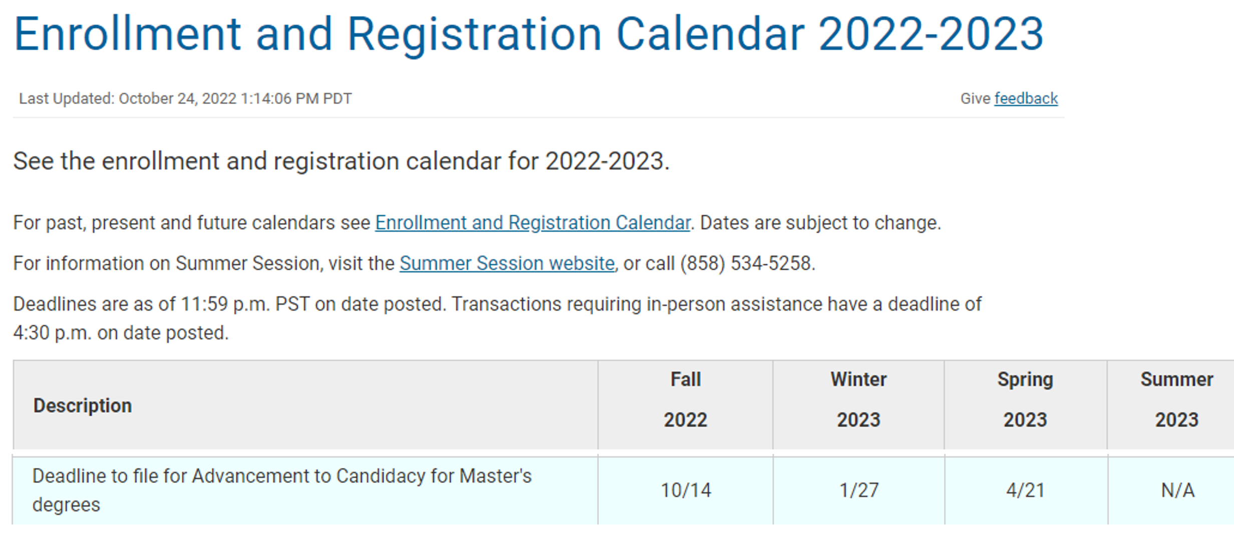
The APPC deadline and many other important dates and deadlines are found on the Registrar’s Calendar here: https://blink.ucsd.edu/instructors/courses/enrollment/calendars/2022.html
Mark your calendar! The 3rd Friday of each quarter.
But please submit your APPC’s earlier, if you can!

Slide 5
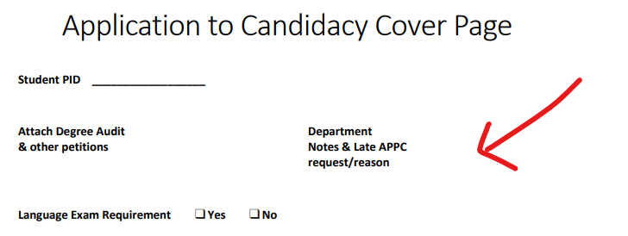
Missed the APPC deadline?
You can submit a late APPC
A late APPC is one that was signed by the dept chair (or their designee), AFTER the 3rd Friday deadline.
In that event, you must write the reason why the APPC is late, in the Dept Notes section of the APPC cover sheet.
If that opportunity is missed, the alternative method is to send an email to the Grad Academic Affairs advisor, stating the reason the form was late & cc your dept chair.
NOTE:
Students must be enrolled in the quarter in which they advance.

Slide 6
Why is the student’s Application to Candidacy reviewed at the beginning of their final quarter?
We want to identify problems that may impact the student’s eligibility to graduate, early on…. so that they can potentially be resolved in time for them to graduate in the quarter that they intended

Slide 7
How do I identify which students need Advancement (APPC) or Graduation (Final Report form) paperwork submitted this quarter ?
The process to identify these students varies by department and may include:
Current enrollment into a final/capstone course
A report to find students who will have completed X number of units at the conclusion of the quarter
Department email/survey to determine students’ advancement/graduation plans
Department email notification of advancement/ graduation deadline (ie. student self-identification)
Consider consulting with other graduate coordinators to find out what works best for them!

Slide 8
PHD who wants a master’s degree along the way or to terminate with a master’s degree
Due to current Duplicate Degree Policy: When submitting a master's degree APPC for a PHD,
always check to see if the student has already earned a previous academic master’s degree.
The process below is found on the Academic Affairs FAQ page:
Does the student have a previous MS or MA degree?
NO - Proceed with the APPC submission
YES -The previous advanced degree was not from UCSD and was in a fundamentally
different discipline:
Submit an email (with the APPC) from the dept chair or other member of faculty leadership,
Confirming approval of the duplicate degree.
The email should state that: The faculty have reviewed the student’s record and have determined
that the second Master’s degree is in a fundamentally different disciplinary field. The student’s
coursework and/or research represents a different type of training than the training received at
UCSD and that the faculty approve conferring a duplicate master’s degree.
YES - The previous duplicate degree was awarded by UCSD or it was in the same discipline
as the degree that the student is currently pursuing:
If you wish to pursue a request for an exception to the duplicate degree policy: Submit an exception letter (with the APPC) for review by the Sr. Assoc Dean.
The email should explain:
How the previous degree/coursework/research was different from the degree/coursework/research that the student is currently pursuing.
How the duplicate master’s degree will benefit the student in their career.
Senate policy: https://senate.ucsd.edu/media/70346/GC-Revision-to-the-Policy-on-the-Duplication-of-Advanced-Degrees.pdf

Slide 9
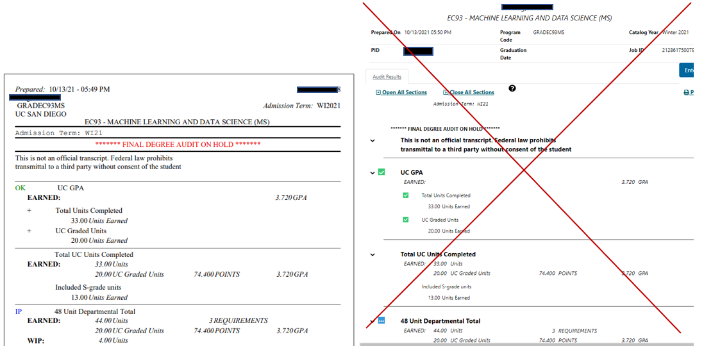
Run uAchieve Degree Audits
Run in PDF format only – not HTML
An HTML version of the degree audit will be returned/declined
HTML
PDF

Slide 10
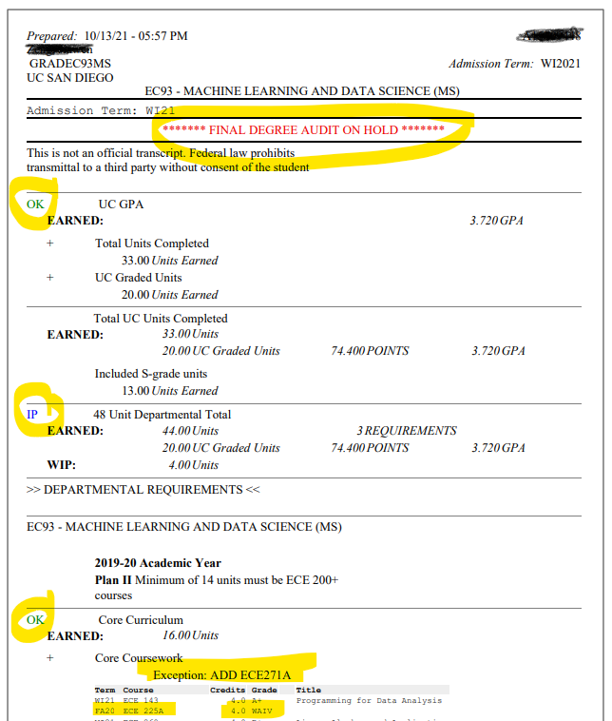
Carefully review each degree audit before attaching it to the APPC cover sheet:
Only submit a uAchieve audit with OK &/or IP on
the left-hand side of the page.
OK indicates that courses used towards that section of the degree audit have been successfully completed.
IP indicates that 1 or more courses in that section will satisfy requirements… once a passing grade is received. (IP means In Progress).
This red text (*FINAL DEGREE AUDIT ON HOLD*) at the top of the uAchieve audit, simply means that there is an ungraded (ie WIP) course on the audit somewhere. An audit with this note is OK to submit. That red text will convert to this green text (*FINAL DEGREE AUDIT*) once all grades are in.
NOTE: Refer to the bottom of this audit to see
properly processed uAchieve exceptions:
Course Substitution note (“ADD ECE271A”)
Undergraduate Waiver (for ECE 225A), showing a grade of “WAIV”

Slide 11
:
The degree audit looks great!
But Wait……
Let’s say the degree audit displays only OK & IP. There are no NO’s printed on it. Do you still have to check all of the courses and grades on the uAchieve audit before submitting?
YES.
There are several reasons why the degree audit might show that the student has successfully completed all their requirements….when that isn’t the case.
A coding error behind the scenes that will erroneously allow a course to satisfy a requirement
A recent change in the program’s curriculum that hasn’t been updated on the audit yet
A uAchieve manual exception that was processed incorrectly
Dept requires letter grades, but student is currently enrolled in a course under an S/U grade option:
Note: In this case, once the “S” grade comes in (and the audit is run again), the course will not be allowed to satisfy the requirement (ie it will be “kicked out” of the degree audit). Until then… the audit will think this WIP course is OK to satisfy the letter-graded requirement, even though the student is enrolled in it as S/U.

Slide 12
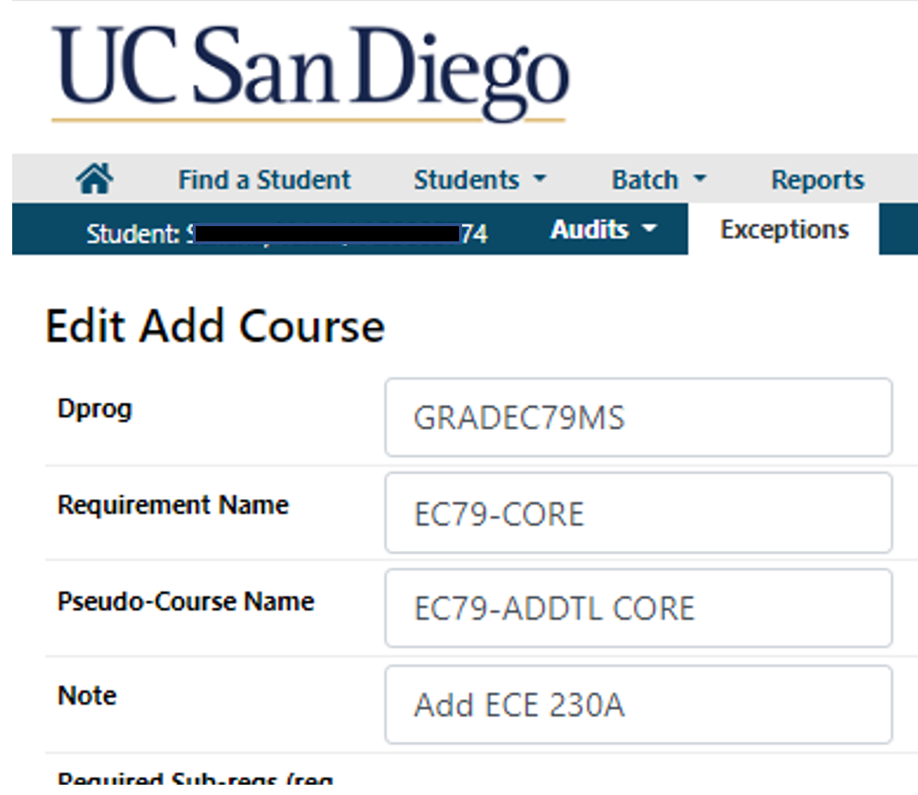
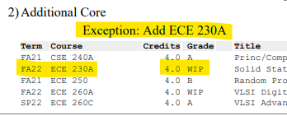
OPPOSITE SITUATION: The degree audit says that the student has NOT successfully completed their program - but you know that they have!
2 common reasons why this would happen:
1.) The student is using a course towards their program that is not normally acceptable/listed in the curriculum.
Assuming the dept has approved the student to use this course, a manual course substitution must be processed (aka a uAchieve exception). This will force that course into the correct spot on the degree audit.
To receive training in How to Process uAchieve Exceptions, please contact Ken Keziah in the Registrar’s Office: kkeziah@ucsd.edu
Example: Dept has approved an exception to allow this student to use ECE 230A in the core.
Dept inputs this exception into uAcheive
Exception & note appear on the printed audit
2.) The degree audit is not working correctly, or it has not been programmed to reflect recent updates in curriculum.
Short-term solution (to submit APPC by the deadline) may involve processing an exception, to force courses where they belong.
However, the issue needs to be resolved permanently, for all students. This will require a ticket to uAchieve encoders. Send email to uachieve@ucsd.edu and cc your Graduate Academic Affairs advisor (or contact us to discuss).

Slide 13
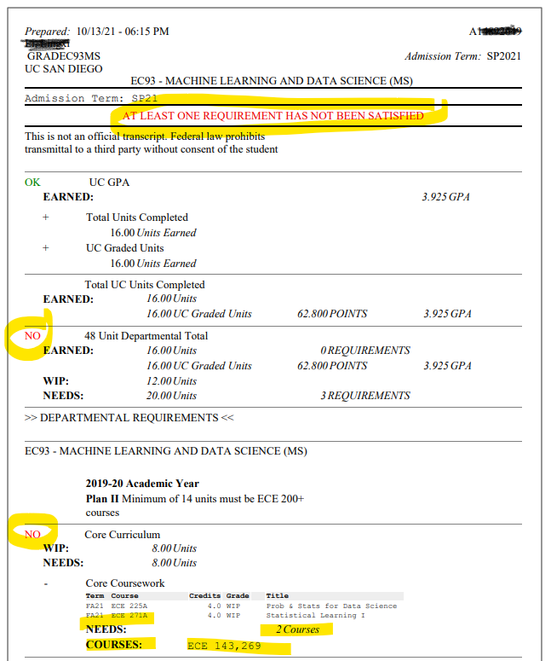
Additional potential reasons for a NO on a degree audit:
GPA below 3.0
Student fails or withdraws from a course
Did not complete enough units/courses
Completed a course with an “S” grade, but program requires letter graded courses
Enrolled in a course that was not included in the approved curriculum for that program (ie took the wrong course). That course will be posted at the very bottom of the audit (ie in the “courses not used towards program” section)
Do not submit a uAchieve audit/APPC when there is a red NO on the audit*, or if the following text appears at the top:
“At Least one requirement has not been satisfied”.
*Exception: APPC can be submitted with a red NO only if it relates to a low GPA. In that event, we will hold onto the APPC and process it, if/when the GPA increases to 3.0+ at the end of the quarter.

Slide 14
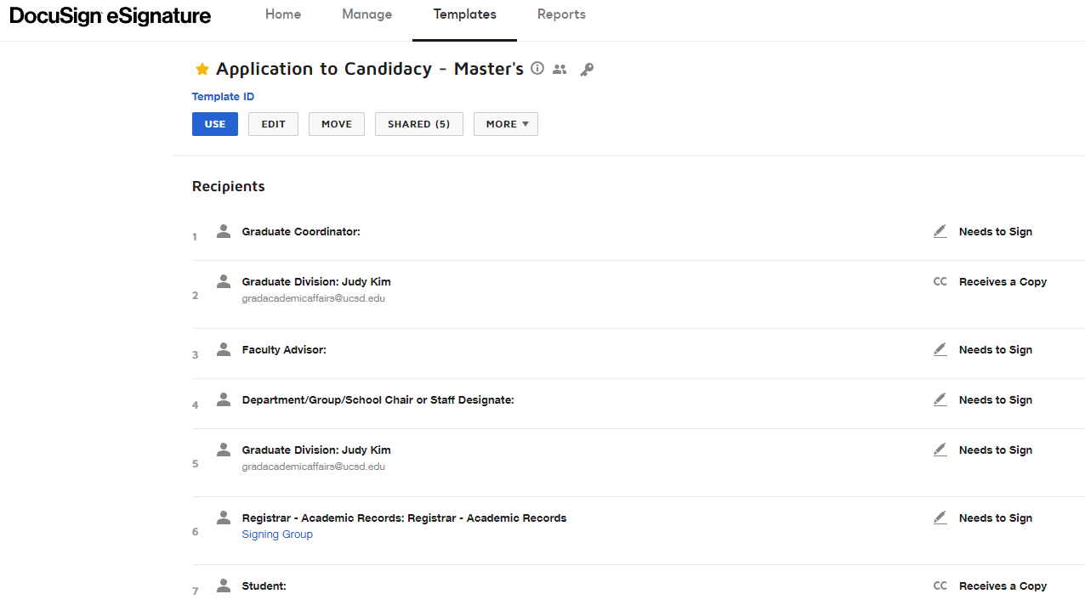
Submit the APPC
Access DocuSign form via Collab
Fill out routing info
Fill out cover sheet
Adjust subject line, which must include:
Student’s name
PID
Major Code
The Words, “APPC” or “Application to Candidacy” (which auto fills)
Attach PDF version of the student’s uAchieve audit
Submit the Form
Make sure that the dept chair (or their designee) signs the form by the APPC deadline date
NOTE: the form will not route to GEPA until the final dept signature is on the form.

Slide 15
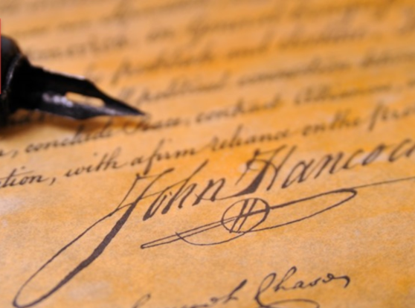
Signatures
All signatures on the APPC are obtained via DocuSign
Departments can opt to require/not require the student’s faculty advisor to sign the form
Departments can opt to have a designated person (usually the graduate coordinator) sign the APPC, in lieu of the Department Chair.
The department is responsible for monitoring the faculty/staff who are authorized to sign the APPC’s. Graduate Academic Affairs (GAA) does not track who is authorized to sign in every department.
Once the final department signature is obtained, the APPC will be routed to GAA for reveiw
The APPC is considered “received” by the GAA, on the date that the final department signature is obtained.

Slide 16
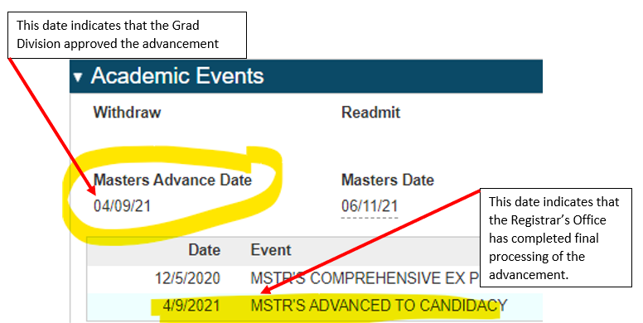
Has the APPC/Advancement been processed for my student yet? Check the Academic Events section of the Graduate Student Database

Slide 17
Graduation Timeline: Plan II (comp exam)
NOTE: This is a typical timeline. It may vary by department. For example, some departments have their students take the comp exam prior to their last quarter of enrollment (aka prior to advancing to candidacy)
Student enrolls in final quarter/courses
2. Dept submits APPC by 3rd Friday of the quarter in which student is enrolled in their final course(s) to be used towards their program
3. Student completes Comprehensive Exam
4. Dept submits Final Report Form by last day of student’s graduation quarter

Slide 18
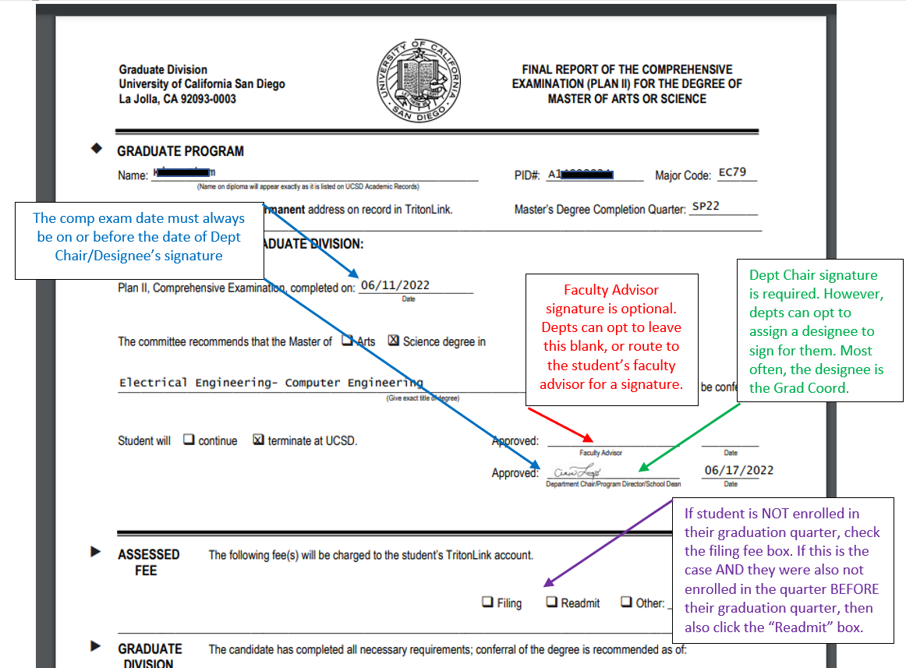
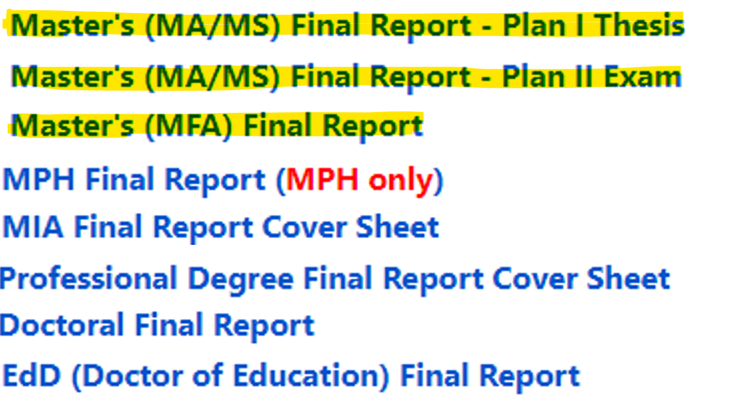
Plan II (comp exam)
Final Report Form (FRF)
DocuSign form, accessed via Collab
There are multiple Final Report Forms
in collab. Select the correct form:

Slide 19
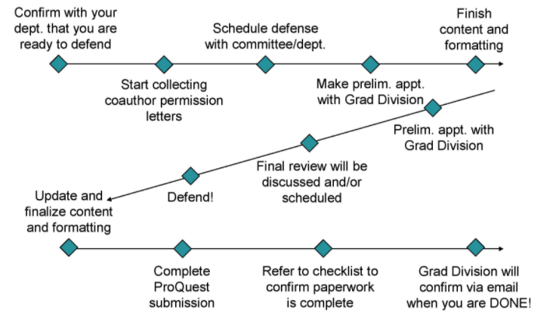
Graduation Timeline Plan I (Defense & Thesis)
Student enrolls in final quarter/courses
Dept submits APPC in first 3 weeks of the quarter in which they are enrolled in their final course(s)
Student/Dept submits the committee for approval at least 2 weeks prior to their defense AND before the student’s Preliminary Thesis Review with GAA
Student works with committee to schedule defense
Student meets with GAA for review of Thesis & discussion of paperwork deadlines
Dept submits the Final Report Form via DocuSign a day or two prior to the scheduled defense
Student defends
Student ensures all graduation-related documents have been submitted by the deadline
GAA performs the Final Document Review & notifies student of thesis/paperwork status via email. Note: we do not meet with the student
GAA processes degree in the weeks after grades close

Slide 20
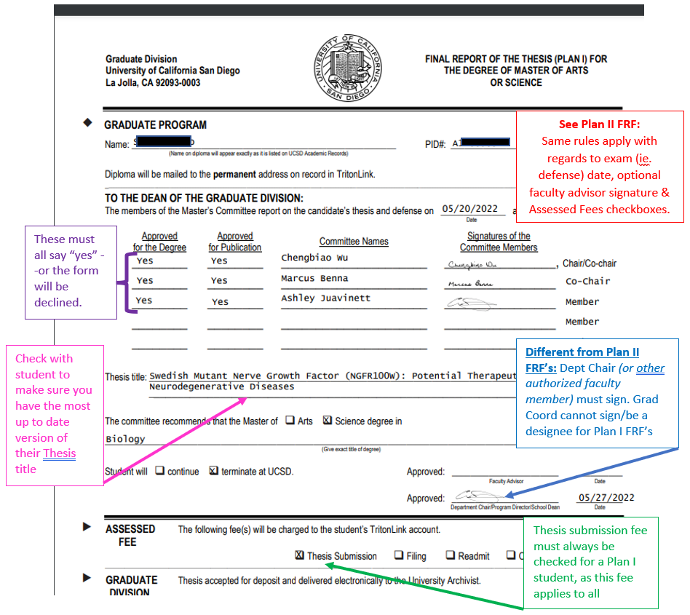
Plan I: Defense & Thesis Final Report Form

Slide 21
Questions? Please contact the Graduate Academic Affairs Advisor assigned to your department: Kelsey Darvin (BIO, ECE, SE, SIO) Karen Villavicencio (BENG, CENG, NENG, CSE) Kim McCusker (all others)

