Slide 1
Tableau Community of Practice
Parameter usage in RS CORE reports
May 17, 2023

Slide 2
Why Use Parameters
Parameters can be used in calculated fields
Parameters can be used in parameter actions
(Filters cannot be used in either of these)

Slide 3
Why Use Parameters
We’ll be looking at some of these.
Parameters can be used in calculated fields
Parameters can be used in parameter actions
(Filters cannot be used in either of these)

Slide 4
What are some things parameters in calculated fields can do?
Single input to filter multiple data sources w/o blending (ie. Project Costs & GL Transactions)
Single input to filter across multiple values (ie. Project Manager & Task Manager)
Recreate familiar textbox input style with greater input flexibility
Implement minimum filter requirements agnostic of any specific value
Provide user with control/options
User Experience
At the most general level, parameters put the burden of complexity on the developer and act to streamline &/or enhance the user’s experience.

Slide 5
Payroll History Report: Report Purpose
Business Use: Review & reconcile labor ledger payroll.
It is essentially a pre-built aggregation of Labor Ledger data saving the user from needing to do a few steps.
Different dashboards have different levels of detail available. Parameters are used to filter as well as give the user control over the report layout &/or content.
Parameter | Primary Purpose
Employee ID(s) | Filter
Employee Name (Last, First) | Filter
End Date | Filter
Fin. Unit(s) | Filter
Fund (CCOA) | Filter
Include Vacation Accrual (Y/N) | Control Option
Index | Filter
Job Code (s) | Filter
Job Title | Filter
Mask Data? | Control Option (available to developer for demos)
Percent Options | Control Option (not implemented)
Project Manager | Filter
Project Name | Filter
Project Number(s) | Filter
Select Date to Filter | Control Option
Select Payroll Type | Control Option
Start Date | Filter
Task (Proj. Required) | Filter
List of parameters used in Payroll History report

Slide 6
Payroll History Report
(Initial version) Single input to filter multiple data sources (not applicable in current version)
Single input to filter across multiple values (ie. Project Manager & Task Manager)
Recreate familiar textbox input style with greater input flexibility
Implement minimum filter requirements agnostic of any specific value
Provide user with control/options
Parameter | Primary Purpose
Employee ID(s) | Filter
Employee Name (Last, First) | Filter
End Date | Filter
Fin. Unit(s) | Filter
Fund (CCOA) | Filter
Include Vacation Accrual (Y/N) | Control Option
Index | Filter
Job Code (s) | Filter
Job Title | Filter
Mask Data? | Control Option (available to developer for demos)
Percent Options | Control Option (not implemented)
Project Manager | Filter
Project Name | Filter
Project Number(s) | Filter
Select Date to Filter | Control Option
Select Payroll Type | Control Option
Start Date | Filter
Task (Proj. Required) | Filter
List of parameters used in Payroll History report

Slide 7
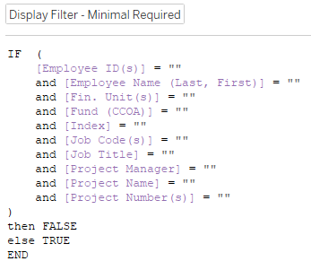
Payroll History Report
Single input to filter across multiple values (ie. Project Manager & Task Manager)
Each parameter & filter-calculation has it’s own calculated field (Original version had one for everything, was hard to troubleshoot.)
Another calculated field defines the minimal requirements that need to be met.
Multiple parameters can all be a part of the same calculated field. Separate calculated fields was an organization choice.

Slide 8
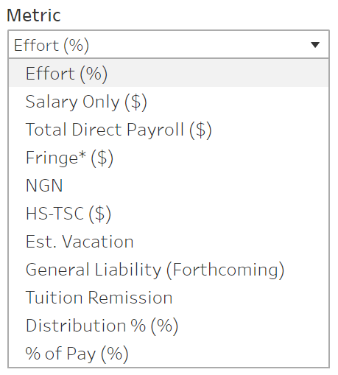
Position Funding Report Parameter: “Metric”
Report uses many similar parameters & filter-calculations as Payroll History
Additional control parameter: “Metric” allows user to select what data they want to view.
List of measure options available to the user

Slide 9
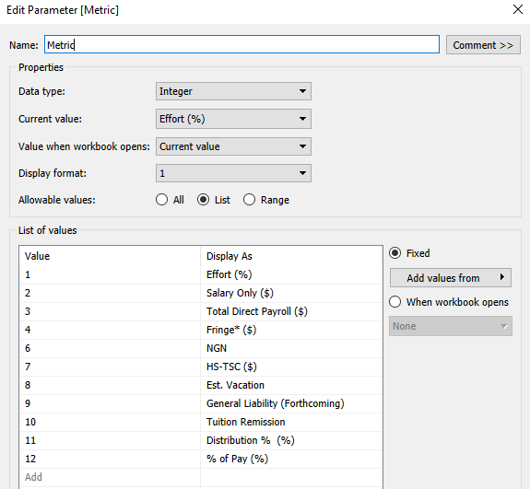
Position Funding Report Parameter: “Metric”
Metric is an “Integer” parameter, but the displayed values are strings.
User sees the above options.
Parameter configuration

Slide 10
Position Funding Report Parameter: “Metric”
Calculated field “Selected_Measure” calculates the value to display based on the user input in “Metric”
Calculated field results determined by “Metric” parameter
Why Integer type? Enables changes to text displayed without modifications to calculated field. Simplified case statement values.
List of measure options available to the user

Slide 11
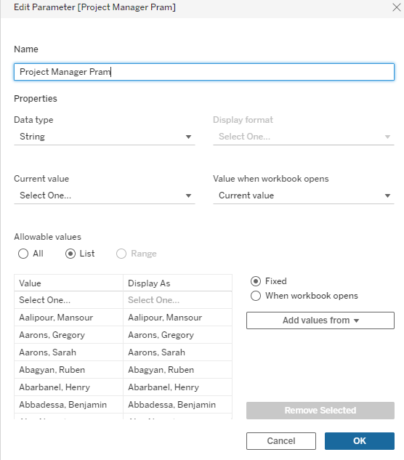
PI Monthly Statement: A Cautionary Tale
Previously…
Project/Task Manager parameter was a fixed list
All Project & Task Manager names were in the list
Manually generated list in excel to combine the two values & get distinct results (requires ongoing manual updates!!!)
Added SIGNIFICANT “bulk” to the report often triggering insufficient memory issues (report wouldn’t even run for large portfolios)

Slide 12
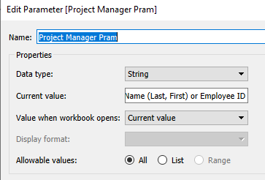
PI Monthly Statement: The Fix
Replace “fixed” dropdown list with type-in
Enabled adding an Employee ID search option
Required incorporating data clean up

Slide 13
PI Monthly Statement: The Fix – String Clean Up
Why are there 3 of these? In this specific scenario, the parameter is being compared to multiple dimensions. Each dimension and the parameter need similar clean up to ensure we’re comparing apples to apples.
Input agnostic of: Capitalization, dashes (2 types), spaces, underscores
Both parameter and original values need the same modifications

Slide 14
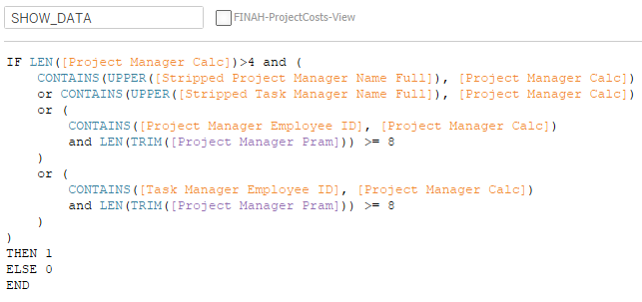
PI Monthly Statement: The Fix – Calculated Filter
Same parameter checks:
Project Manager Employee ID
Task Manager Employee ID
Project Manager Name
Task Manager Name
Minimal character requirement
Possible Enhancement For employee ID, rather than checking if the cleaned-parameter is the substring, the cleaned-parameter could be a list of employee IDs and the calculations modified accordingly.

Slide 15
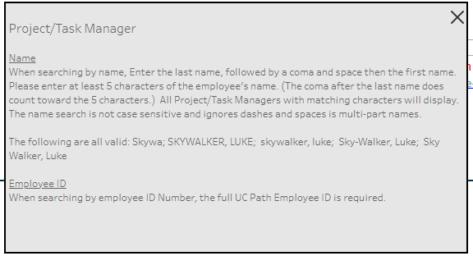
PI Monthly Statement: The Fix – UI & Communication
Current value is set to the field prompt (see parameter config)
Hide/Show Floating container with additional instructions including description of minimum requirements and examples (hide/show button modified to an encircled “i” icon.)

Slide 16
Recommended functions for filtering
TRIM(string)
CONTAINS(string, substring)
STARTSWITH(string, substring)
UPPER(string) (or it’s converse, LOWER(string))
REPLACE(string, target substring, replacement substring)

